Slide 1

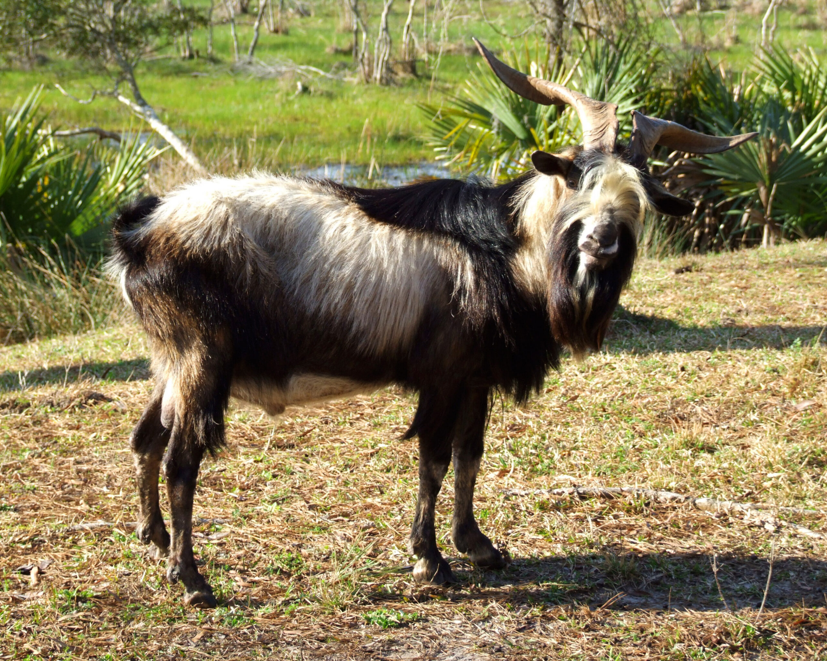
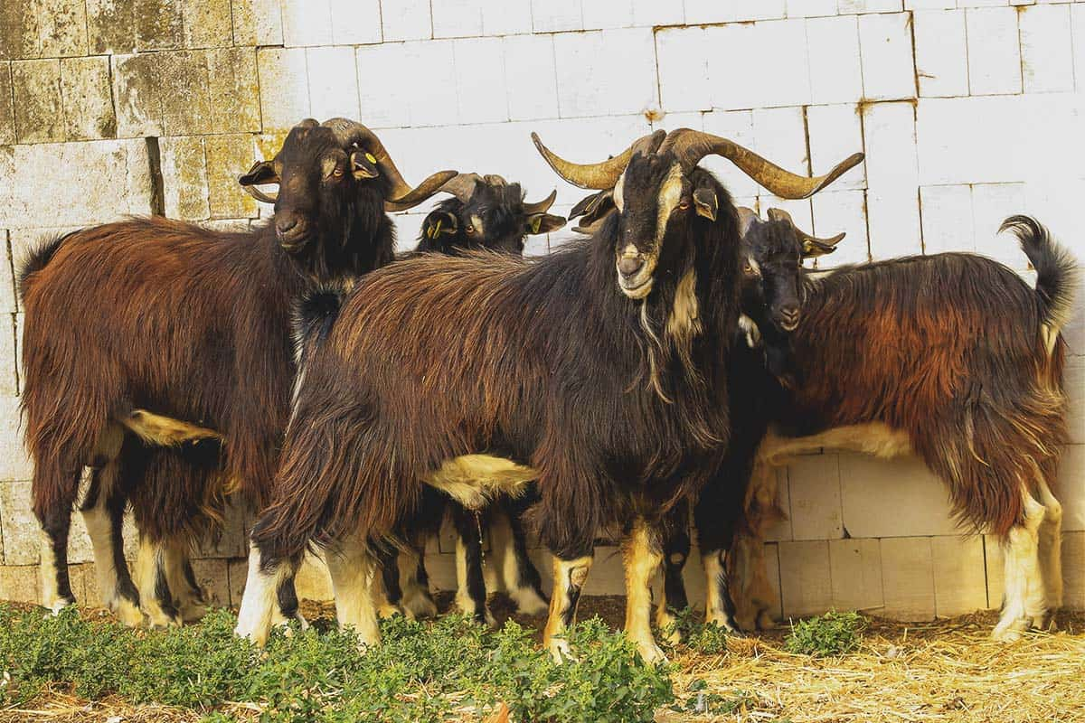
How Stress Affects Meat Quality in Spanish Goats
Sarah Foster
Samy Kushwah
Gabriel Peer-Drake
Steven Miltenberger
Team 10
12/02/2022

Slide 2
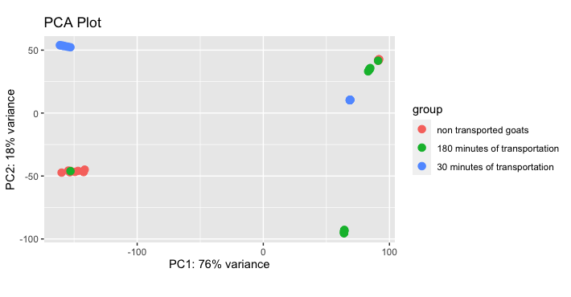
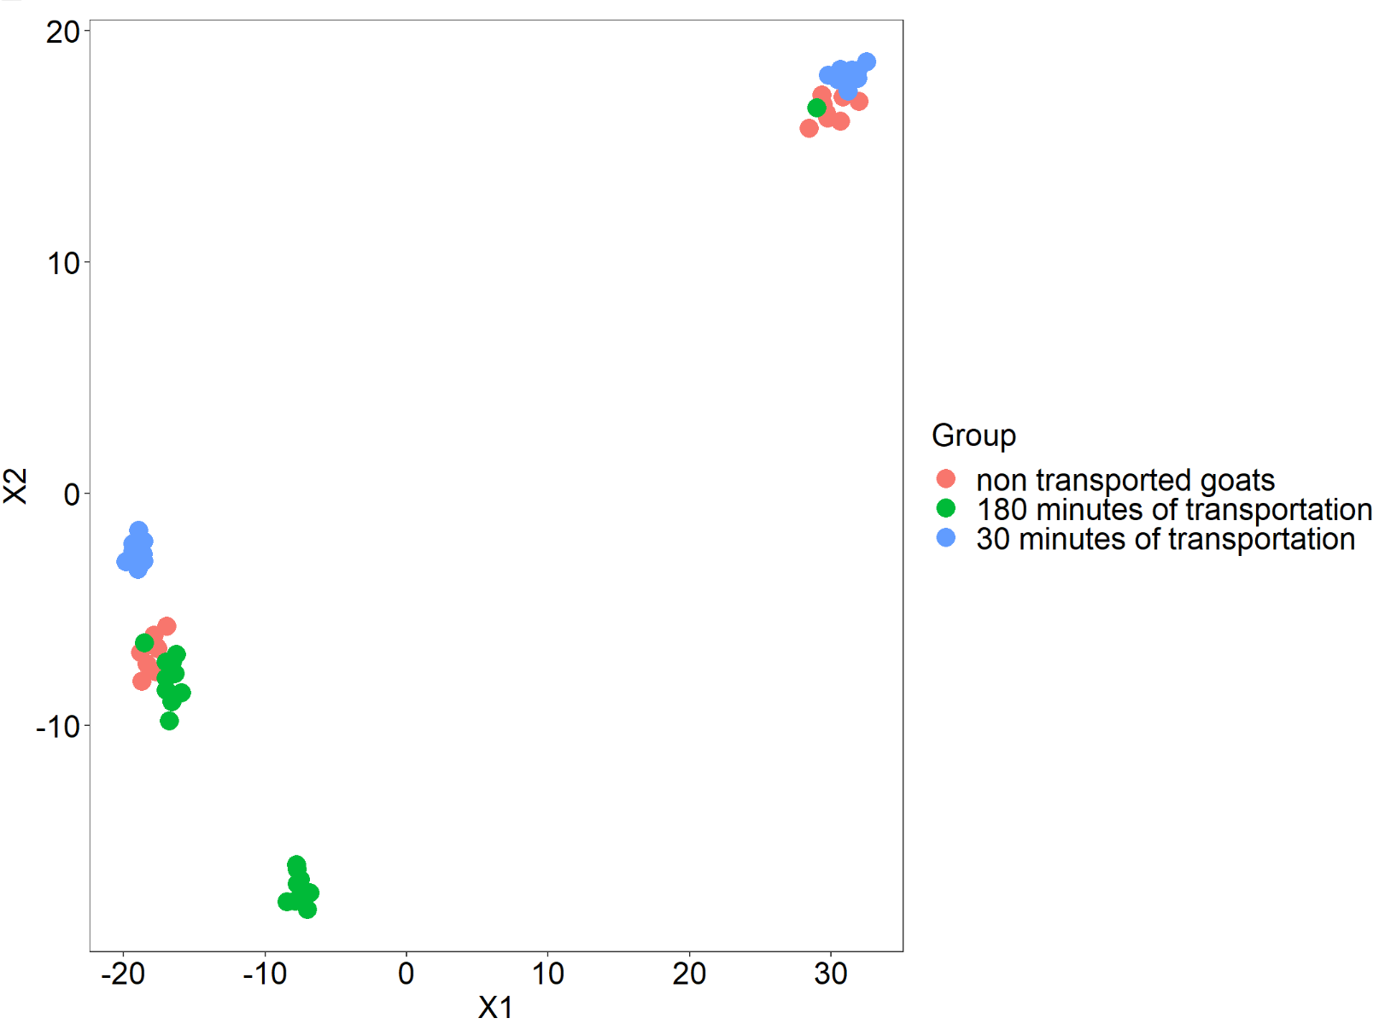
Introduction
Topic and Data
Meat samples collected from 54 Spanish goats
Samples were randomly subjected to one of three treatments:
30 minutes of transportation,
180 minutes of transportation
locked in a pen for control prior to slaughter (0 minutes of transportation)
RNA-Seq data collected from the meat samples.
The data included 23,228 different genes tested in all the samples
Approach
Differential expression analysis on our RNA-seq data
Enrichment analysis
Clustering analysis on differentially expressed genes
Statistical analysis
Tsne plot

Slide 3
Hypothesis
Question: Does stress influence meat quality in Spanish goats that can be observed through a difference in the transcriptome of goats that were stressed or not stressed?
Motivation
Lack of studies focusing on stress and meat quality
Previous research showing stress may affect glycogen levels
Notes:
There are few studies that focus on the transcriptome of stress and how it affects meat quality, especially under the focus of spanish goats. Previous research shows that the expression of stress is identifiable by glycogen levels being lower in goats subjected to stress compared to those not. Based off this research, we hypothesize the question above.

Slide 4
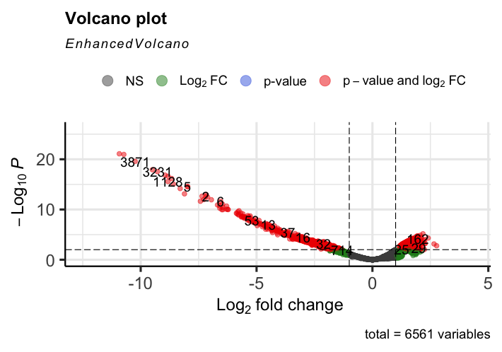
Differential Expression Analysis
Method
Performed differential analysis on all genes using FPKM read counts
Results
Towards the left because the genes are downregulated
Found many genes were differentially expressed
Shows that an answer to our question lies in the significant genes found
Notes:
This means that these genes decrease the amount of a cellular component when responding to outside stimulus

Slide 5
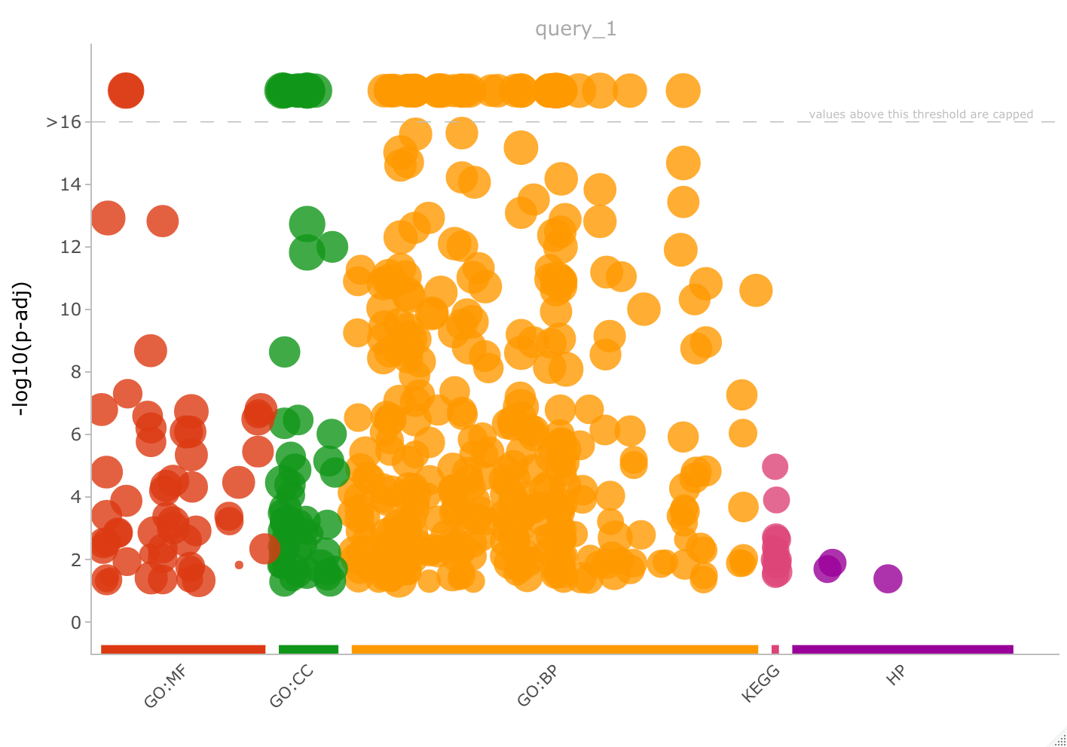
Gene Set Enrichment Analysis
Method
Used gProfiler
Manhattan plot was used to visualize
gProfiler
Results
Genes found mostly in:
BP(Biological Processes) ontology,
MF(Molecular Functions) ontology
CC(Cellular Component) ontology.
Goats are a less common species to study
Surprising how many of the genes were linked to different ontologies.

Slide 6
Assignment 2 Results
Since there were many differentially expressed genes in our dataset, the analysis in Assignment 2 can be used to solve our ultimate question and gives a good foundation for finding clusters in the data.
Despite having issues with gene set enrichment analysis, this shows our question is better answered using different analysis techniques.

Slide 7
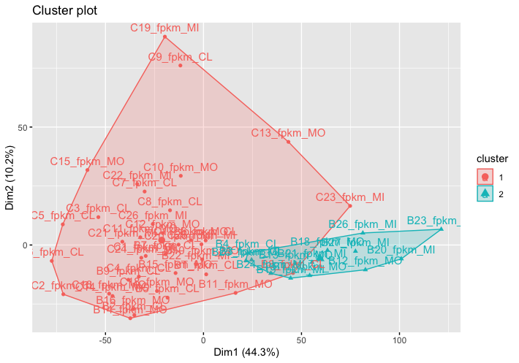
Clustering Analysis: K means
k = 2 was the best value and self chosen
Cluster 1 contains the majority of the control group
Cluster 2 contains mostly affected goats with only one control goat in the cluster.
This indicates that there may be a difference between the stressed goats and control goats.
Notes:
The k means method requires a k to be chosen. As k values were increased, the clusters became less defined and overlapped more, indicating that a higher cluster value did not give better results.
Even as k was increased, there was still a large mixture of affected goats and control groups mixed in the clusters.

Slide 8
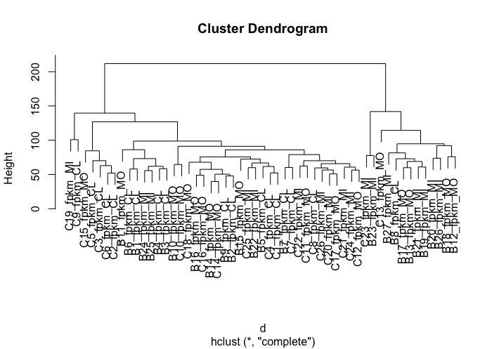
Clustering Analysis: Hclust
This method selected k=2
It can be seen on a lower level that control goats and stressed goats are often grouped together within the clusters
Signifies there may be a difference between the stressed and not stressed goats in terms of expression.

Slide 9
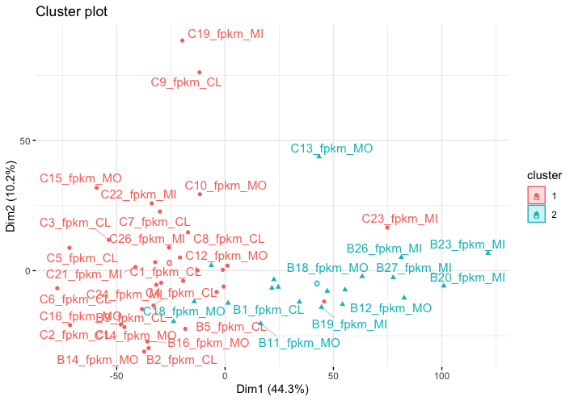
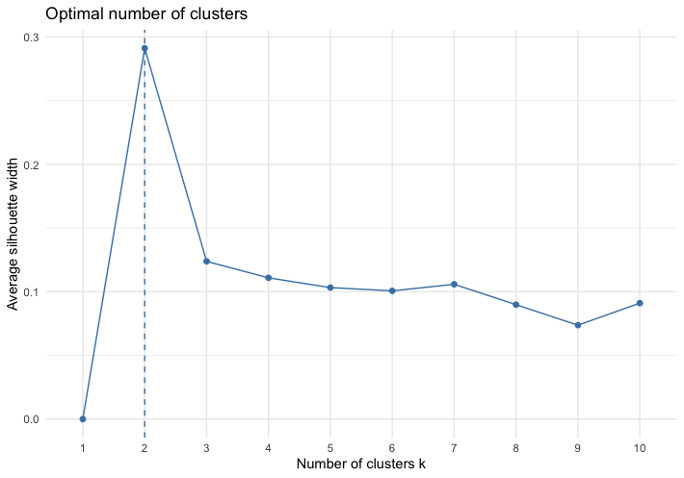
Clustering Analysis: PAM Clustering
The optimal number of clusters was shown to be two
k = 2 was chosen
There is some overlap between the two clusters which makes it difficult to define when one begins and the other ends.
There is a large dominating cluster with the majority of the control group.
The second, smaller cluster, has majority stressed goat groups.
Indicates there may be a significant difference between the control and stressed groups

Slide 10
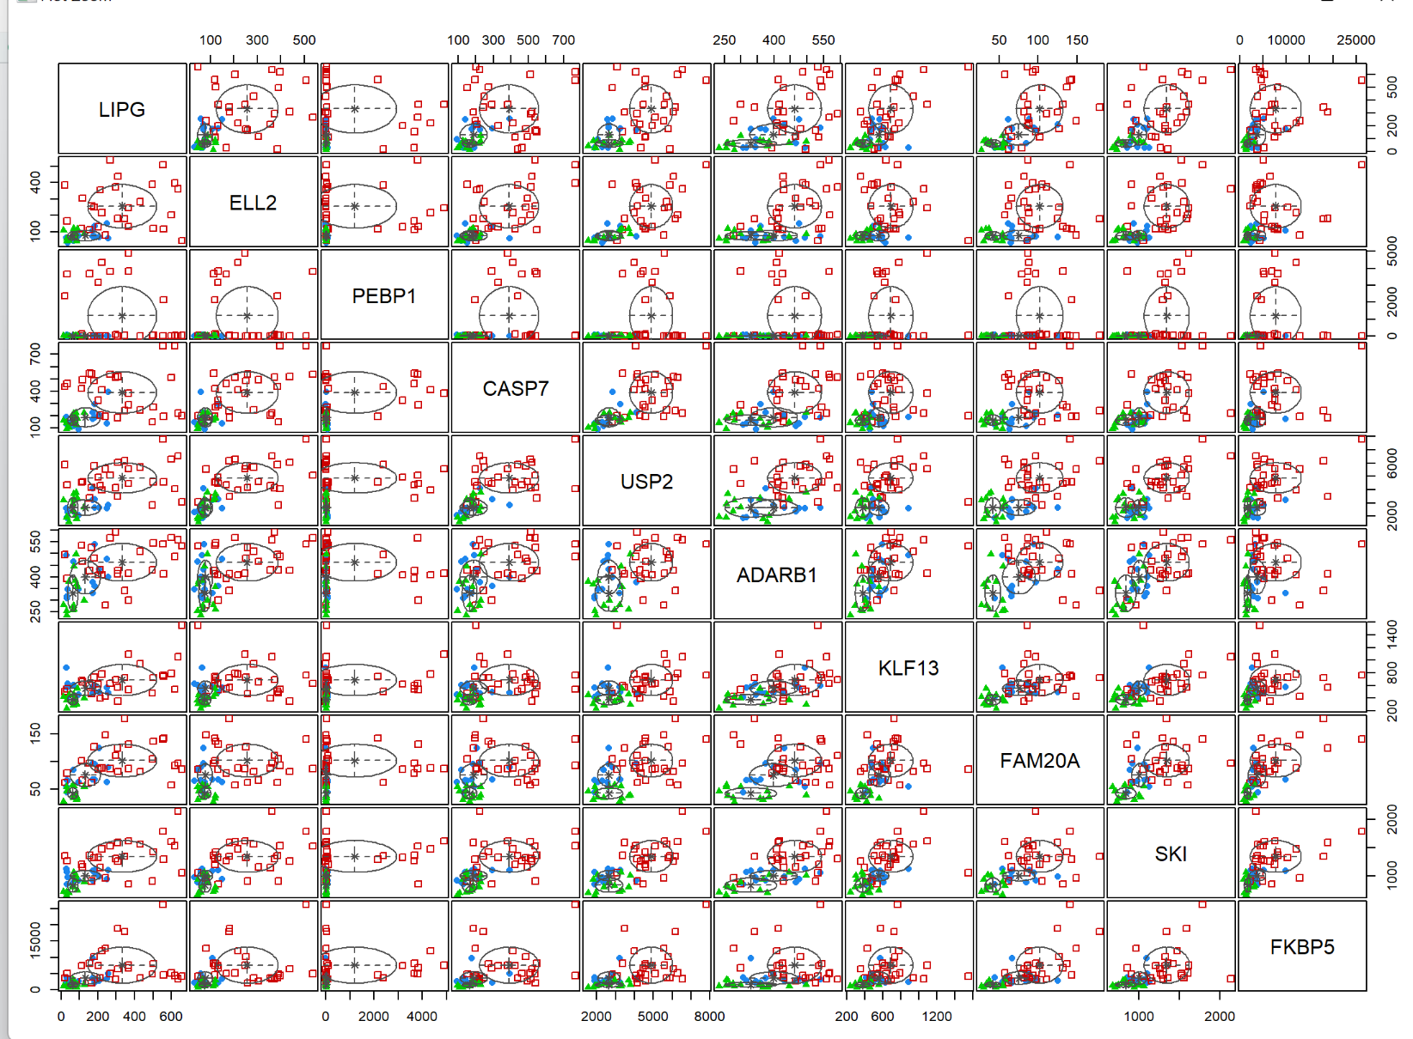
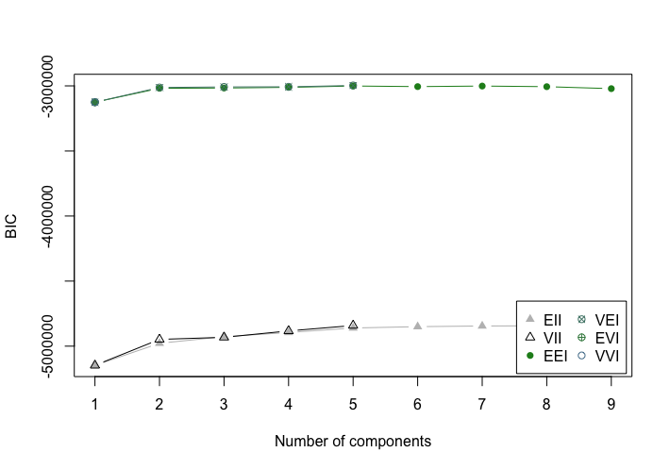
Clustering Analysis: Gaussian Mixture Model
This method did not require a k to be chosen.
The Gaussian Mixture Model (GMM) has many different Gaussians that all use k for the number of clusters in the dataset.
A plot using the “classification” type for 10 isshown on the right. This is a crowded plot and having more than 10 genes would make the plot too large to display, so plotting BIC values is more optimal.
A lot of clusters all align at the point 2 while at other points there are less clustering methods present, meaning 2 is the best number of clusters that comes out of the dataset.
Indicated that two groups may be significant

Slide 11
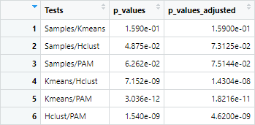
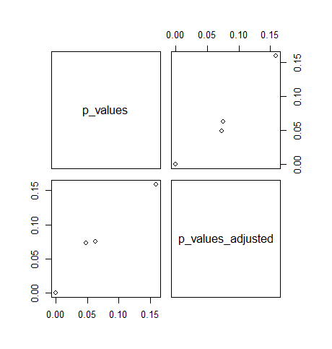
Statistical Analysis
Chi-Square tests of independence ran
On our sample groupings compared to the clusters found using different clustering methods,
Comparisons of cluster methods to other cluster methods.
Original grouping for our samples may not accurately indicate differences in DNA, but there is some characteristic that separates the goats into two groups.
There is a relatively linear trend between the pairs of p values and adjusted p values found from the different comparisons between our sample groups and calculated clusters.
Indicates there is not a significant difference between our groupings

Slide 12
Assignment 3 Results
Expected to find 3 clusters that corresponded to the three different groups.
Results did not fit this expectation
Only found 2 clusters
Clusters were not found to be statistically significant

Slide 13
Conclusions & Future Work
Conclusion
Compiling the results from all methods, our final conclusion is that stress does not affect the transcriptome of goats significantly.
Using differential expression we were able to find differentially expressed genes and a large majority were connected to different gene ontologies.
When we ran all four clustering methods, we found that two clusters were optimal in each of the four methods.
In our statistical analysis, it was found that there was not a significant difference between the two clusters.
Our clusters also did not group the stressed goats and control group exactly, meaning that there was some overlap in differential expression in both groups.

Slide 14
Conclusions & Future Work
What we learned
What we would do differently
Statistical coding in R and and how to use packages related to bioinformatics
How to overcome obstacles in data organization and the processes used in large data sets.
We had more issues with trying to do the ontology methods since goats do not have readily available databases in these ontologies. We would do more research about other data existing on our species before picking it to run analysis on. We would have chosen a different species since goats have less data.
New Question
We had a hard time meeting up this semester since our schedules did not align. We would try to meet up in person more if we could so we could see each others progress and aid each other when help is needed.
What characteristics separate Spanish goats into only two groups found through our experimentation?

